Slide 1
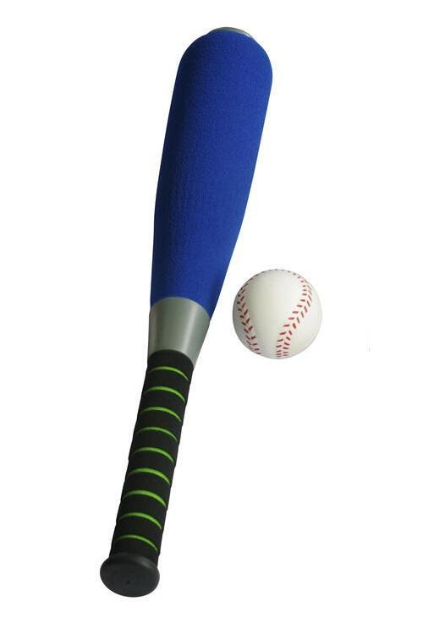
Quick Maths
Fastest Correct Answer gets a prize!

Slide 2
Learning objectives – situation awareness
A bat and a ball together cost £1.10
The bat costs £1.00 more than the ball
How much does the ball cost?

Slide 3
Learning objectives – situation awareness
10 pence?
5 pence
Bat + Ball = £1.10
Bat = Ball + £1.00
Ball = £1.10 – Bat
Ball = £1.10 – (Ball+ £1.00)
Ball = £0.10 – Ball
Ball + Ball = £0.10
2 Ball = £0.10
Ball = £0.05

Slide 4
Why does £0.10 come so easy?
Substitution and Cognitive ‘Misering’
Brain sees a problem
Notices a related (and far easier) solution
Answers the easier question (what is the difference between £1.10 and £0.10)
Doesn’t notice the substitution
“System 1” takes shortcuts.

Slide 5
Linda
Linda, is a 31-year-old, single, outspoken, and bright philosophy major who was deeply concerned with issues of discrimination and social justice and participated in anti-nuclear demonstrations.
Which is more likely.
Linda is a bankteller
Linda is a bankteller and active in the feminist movement

Slide 6
Linda
Banktellers
Feminists
Banktellers who are also feminists

Slide 7
Representativeness Heuristic
Whatever the probability of Linda being a bankteller is, the probability of her being both a bankteller and a feminist is smaller. All feminist banktellers must also belong to the bankteller group.
Probability of (Bankteller AND Feminist) <= (Bankteller)
This is a form of conjunction fallacy – two things occurring a certain way is less likely than only one of those things occurring a certain way.
The brain relies on a heuristic, “representativeness” – Linda being a feminist seems more representative of who we think Linda is from the description, the mental shortcut overrides the mathematical certainty.

Slide 8
MMME4054 Week 4 – Decision-Making Are humans “rational”?
Dr Kyle Harrington

Slide 9
Are Humans “Rational”?
The great debate.
Various schools of thought over the centuries, “man as a rational animal”, Freud’s idea that we are driven by subconscious and irrational desires.
The basic framing of traditional economics, game theory – humans as self-maximising rational agents.
Today, we will look at three different views. Naturalistic Decision Making – Heuristics and Biases – Rational Choice Theory

Slide 10
Learning Outcomes
By the end of this session you should be able to…
Describe three basic theoretical frameworks of decision-making
Understand a variety of cognitive biases and heuristics and how they might apply to design
Critically analayse and compare the three frameworks.

Slide 11
The Three Approaches
 | Rational Choice Theory | Heuristics and Biases | Naturalistic Decision Making
Central Idea | Humans behave rationally | Humans rely on heuristics and shortcuts. | Humans behave sensibly and can make rapid decisions under pressure
Main Theorists | Many (for instance Down’s 1957) | Kahneman and Tversky | Gary Klein
Areas of application | Economics, Political Science | Economics(ish), Psychology, Government, “Nudges”, “Freakanomics”, Behavioural economics | Training, Education, Psychology, Human Factors
Sources of Evidence | Mathematical Models, Computer simulation, Axiomatic Assumptions | Lab based experimental conditions | Study of Experts
Limitations | More of an “assumption” than a proper theory | Lab conditions and “forced choice” are not actually how people make decisions. | More descriptive, less predictive – focus on experts, not everyday scenarios

Slide 12
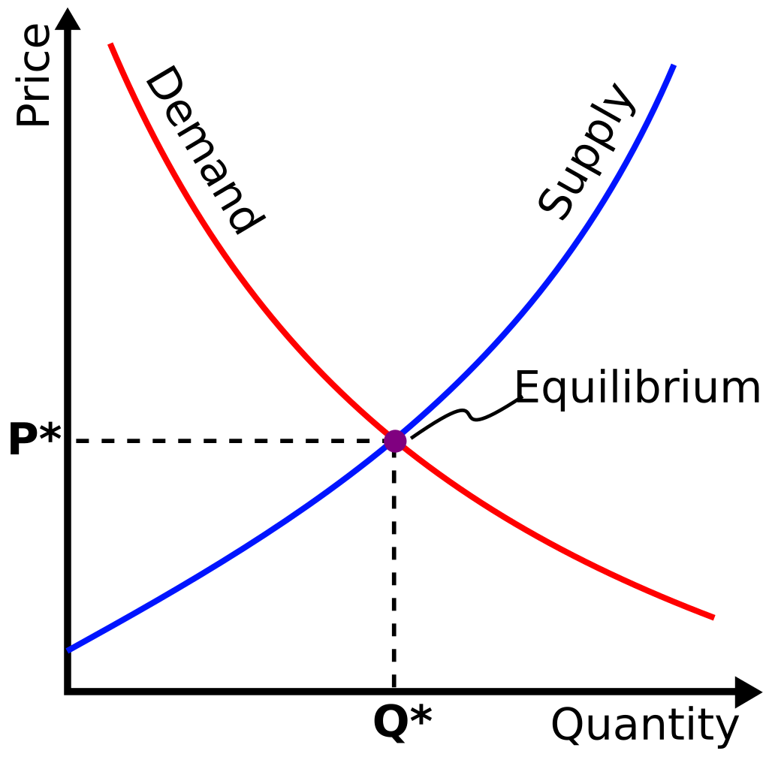
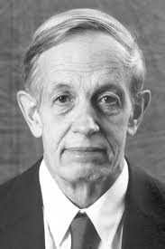
Rational Choice Theory – Humans are Rational
Humans are rational beings, who will make optimal choices to maximise their own self-interest.
Often used as an assumption in economic theory for models about human behaviour.
Assumption in “game-theory” and those applications which use it (including “Selfish Gene” approaches Dawkins).
There are nuances, e.g. Nash Equilibrium.
More of an assumption, than an evidence-based theory. People don’t always behave like this.

Slide 13
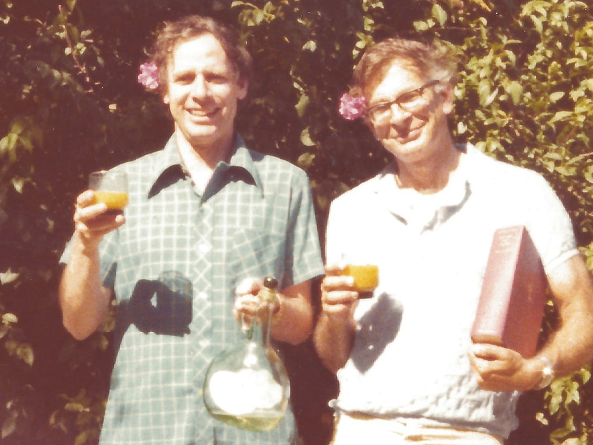
Heuristics and Biases – Humans are Irrational (ish)
As early as the 1950s, some scepticism in economics began to cast doubt on the assumptions of “rational choice”.
Simon, Models of Man (1957) begins to argue for a bounded rationality, and humans as satisficing (not optimising) agents.
In Judgement under Uncertainty: Heuristics and Biases, Kahneman and Tversky (1974), begin to argue for a more radical departure from rational choice – arguing that heuristics lead often to systematic and predicable errors.

Slide 14
What is a heuristic?
A heuristic is a “good rule of thumb”, or a mental shortcut that people can use to solve problems quickly.
It is not always accurate, but most of the time it is “good enough”.
It has the potential for systematic biases.
These strategies may be favoured by evolution because thinking is hard! – Often too slow for split second decision-making, and heuristics can help humans arrive appropriate (if not optimal) at decisions in the absence of perfect information.

Slide 15
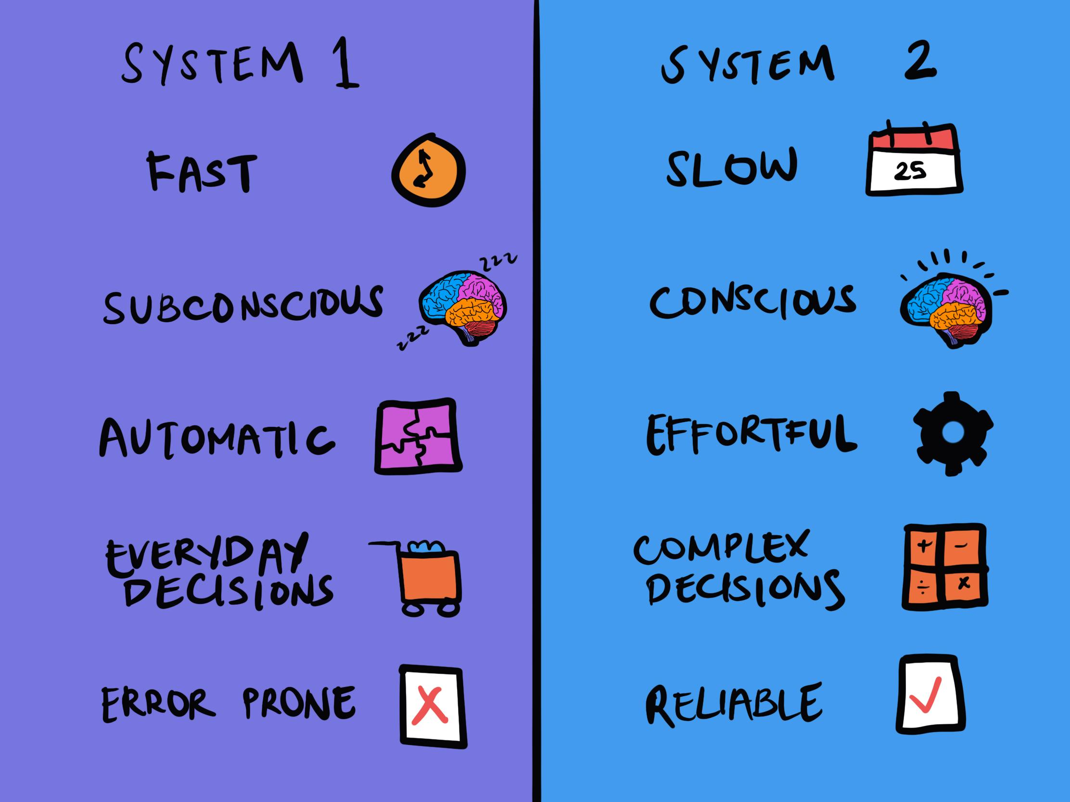
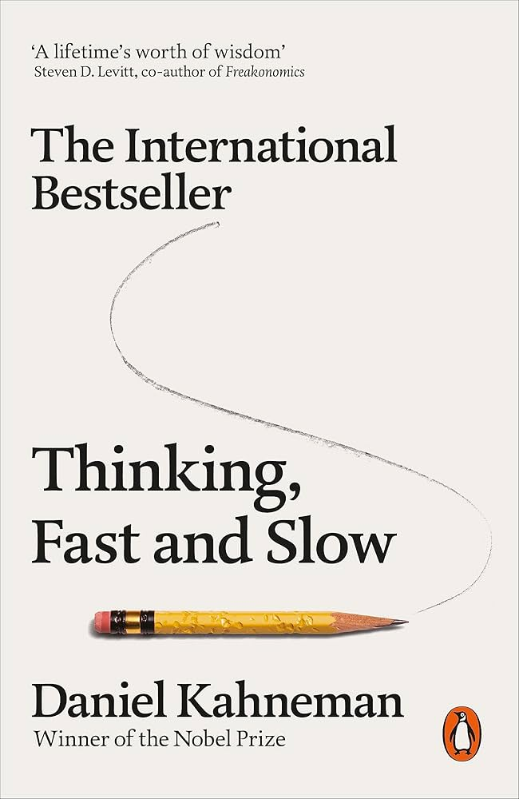
Dual Process Model of Decision-Making - System 1 and System 2
In “Thinking Fast and Slow”, Kahneman suggests two psychological processes for decision-making.
“System 1”, is fast and automatic, but it is lazy, prone to shortcuts and errors.
“System 2” is slow and deliberative; it is effortful but far more reliable.
Those of your who shouted out “10p” at the start of the lecture were using system 1.
When you were thinking about how to structure and write your coursework, you were using system 2.

Slide 16
Some Biases and Heuristics
A company pays £10,000 to update its software system. It is far more unreliable than the previous system. But management decides to continue using the new system because of money already invested.
An aerospace company has spent £10M designing a new aeroplane, halfway through the design, they realise that there is no demand for it, and it will not make any money. They decide that they have already invested so much, so will continue to design it.
Tom purchases a movie ticket online for £12.50 and upon arriving at the theatres to watch the movie, Tom realizes that the movie is really boring and does not appeal to him. Tom decides to sit through the entire movie because he already bought a ticket.
“In for a penny, in for a pound”.
“Throwing Good money after bad”

Slide 17
Sunk Cost Fallacy
The “sunk cost” fallacy is erroneous because the decisions should not be based on previous (sunk) expenditures.
Decisions should only consider the costs and expected benefits of continuing. Money (or time) already spent, cannot be gotten back.

Slide 18
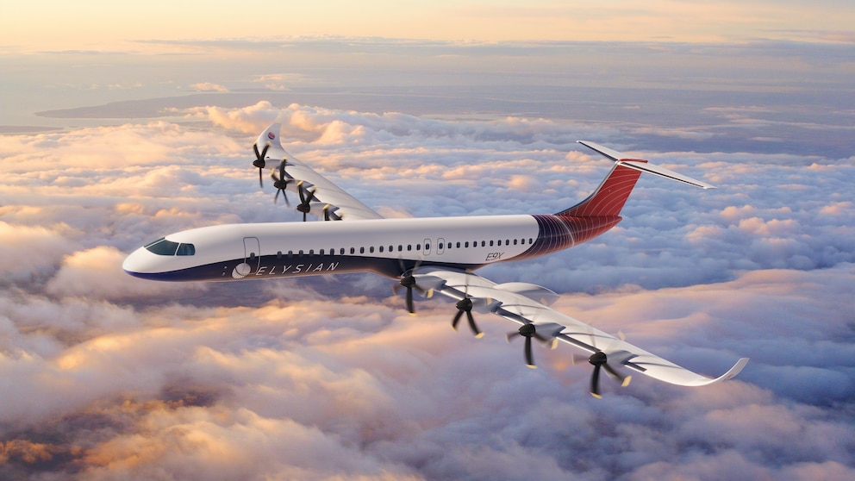
Some Biases and Heuristics
After watching a horrific documentary series about serial killers, Tom no longer feels safe in his hometown, even though homicides have been declining for decades.
A recent plane crash has made the news, and it makes Rebecca very nervous about flying. Rebecca drives every day, which is objectively far more dangerous. Rebecca has overestimated the likelihood of plane crashes due to emotionally charged news.

Slide 19
Availability Bias / Availability Heuristic
Events which are more shocking, more commonly reported or more memorable are easier to recall.
This availability of recall often makes them seem more probable – when that is not always the case.
It is almost like we arrive at our estimate of probability based on ease of recall. “easy to recall => must be common”, “difficult to recall => must not happen a lot”

Slide 20
Some Biases and Heuristics
Would you rather be given £100, or have a 50% chance to win £250?
Participants were either given a mug or a pen as part of an experiment, these had approximately the same market value, very very few were willing to trade (Kahneman, Knetsch and Thaler)
“Free trials”, companies rely on either endowment effect (new sense of ownership), or cynically forgetfulness.
…have you seen what people think they can charge on FB marketplace?

Slide 21
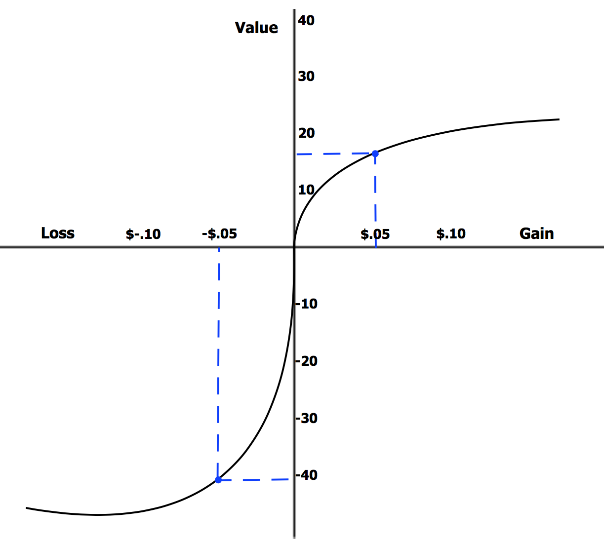
Loss Aversion and Endowment Effect
Related heuristics
Loss Aversion is the likelihood fearing losses at approximately twice the rate of seeking gains.
The Endowment effect is the tendency to value things already in your possession at around twice the actual rate.

Slide 22
Some Biases and Heuristics
Jeff is prepared to spend £20 on a new shirt for his graduation. When Jeff goes to the shop, he notices an £80 that would be appropriate and thinks it far too high. Finally, he sees a similar £40, which he now decides is a good deal.
Emad is looking for a new laptop, he has budgeted £700 for a mid-low end spec laptop. When arriving at the store, he sees a laptop reduces from £2000 to £1000 and decides to buy it.
The initial (often arbitrary) sentencing demands of criminal prosectors has been shown to influence the eventual sentences received by people found guilty.
When people are asked to guess how many marbles there are in a big glass jar, initial estimates tend to affect the subsequent estimates.
A doctor who is more likely to place greater emphasis on the first symptom described by the patient, even if other symptoms are more relevant.

Slide 23
Anchoring Effect
Often seeing a cost or value sets an “anchor” point, by which to compare similar things, even if the anchor is entirely arbitrary.
The first piece of information is often seen as the most important, and all subsequent pieces of information are compared to the first.

Slide 24
Heuristics and Biases
Scenario 1:
Imagine you are about to buy a jacket for $125 and a calculator for $15. A salesperson informs you that the same calculator is on sale for $10 at another branch of the store, a 20-minute drive away.
Result: Approximately 68% of people said they would make the trip to save $5.
Scenario 2:
Imagine you are about to buy a jacket for $15 and a calculator for $125. A salesperson informs you that the same calculator is on sale for $120 at another branch of the store, a 20-minute drive away.
Result: Only approximately 29% of people said they would make the trip to save the same $5.

Slide 25
Mental Accounting and Mistaking Relative and Absolute Values
In both scenarios, people are asked to drive for 20 minutes to save $5, but the likelihood of people doing so drastically changes.
They are comparing the relative saving as a proportion of their purchase because of framing effects, but the cost and savings are the same in both cases.
“The chance of a successful operation is 90%” ☺
“The chance of an unsuccessful operation is 10%” ☹
Suppose the risk of heart disease was 1% overall, and that eating Twixes increased this to 2%.
“Eating such and such in your diet increases your risk of heart disease by 100%”
“Eating such and such in your diet means that your overall chance of getting heart disease increases by 1%”

Slide 26
Heuristics and Biases
A student has decided that they do not like their cognitive ergonomics class. They decide that the lecture materials are boring, the lecturer is eccentric, yet dull, and the quizzes are tedious. They make a mental note of anything that confirms what they believe whilst disregarding that which argues against it.
A famous scientist has invested much of their career developing and expanding upon a theory of molecular chemistry, but the peer reviewed evidence is mixed. When defending her position, she puts great emphasis on papers which show her pet theory to be correct, whilst downplaying or disregarding competing evidence.

Slide 27
Confirmation Bias
The tendency to seek out, value and favour evidence for positions we already believe, whilst disregarding alternative evidence that may make us challenge our beliefs.

Slide 28
Biases and Heuristics
Bias | Explanation | Example
Substitution | Swapping hard problems for easy | Bat and a ball
Representativeness | Making assumptions and stereotypes | Linda the bankteller
Sunk-costs | “Good money after bad” | Watching a film after you released it will be terrible.
Availability Bias/Heuristic | Overestimating improbable but salient events | Plane crashes, news stories, etc.
Loss Aversion / Endowment | Valuing things we have at twice the rate they should be | Valuing the pen over the mug, not taking risks when we should, not seeing “forgone gains” as we see losses.
Anchoring | Initial information influencing subsequent information | Emad’s laptop, Jeff’s shirt
Framing | How things are framed effecting decisions | Chance of success 90%, chance of failure 10%
Confirmation Bias | Overvaluing things we already agree with | …just look at online arguments

Slide 29
More on “Prospect Theory”/ Heuristics and Biases
HUGELY influential (Kahneman won the Nobel prize, Best Selling book)
Inspired “Freakanomics” podcast and many others, known of in popular culture.
“Nudge” book. Libertarian Paternalism
UK Government “Nudge”/ “Behavioural Insights Team”
Quite a negative view of human autonomy?
Dark patterns, manipulation online.
Much of this is gathered from forced choice experiments in contrived lab conditions, not exactly how people behave and make decisions in real life.

Slide 30
Class Activity
The hospital is updating its electronic prescribing system. A proposal has been made to add a new automatic pop-up alert that warns prescribers of potential drug interactions every time they order a medication. The design team must decide whether to implement the alert.
Arguments For Adding the Alert
A pharmacist mentions a recent case where a patient almost received a dangerous combination. The story was dramatic and has been retold several times in meetings.
A junior doctor says, “I’ve seen similar alerts in other hospitals—it’s clearly the standard now.”
Early prototype testing with 4 clinicians had positive reactions: “It feels safer.”
The alert is framed as “a simple step to eliminate preventable harm.”
The team has already spent two weeks developing the alert logic.
Leadership says this could be a “future-proof approach as prescribing becomes more complex.”
Arguments Against Adding the Alert
Senior clinicians worry it will contribute to alert fatigue, since there are already many pop-ups.
A designer argues the current workflow “works fine for most cases” and the alert would interrupt tasks.
Another clinician recalls one case where a pop-up alert in another system caused confusion and slowed a resuscitation scenario.
Usage analytics show that interactions occur in only 0.05% of prescriptions—very rare.
A competitor hospital recently removed similar alerts after complaints, which one team member mentions repeatedly.
Developers say removing or delaying the alert means “we stay efficient and avoid clutter.”

Slide 31
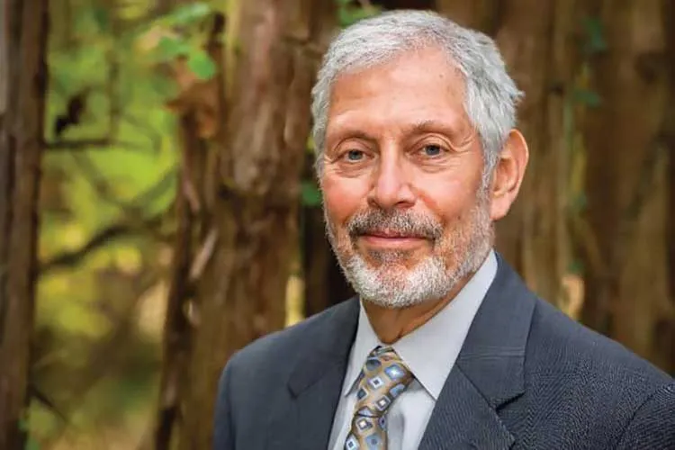
Another View
“Naturalistic Decision Making”
Humans often make excellent, split-second decisions with only limited information. They draw on tacit [implicit] knowledge to arrive at these decisions. They are capable of great insights, in the natural environments in which they usually operate.
Gary Klein was interested in how experts (such as firefighters) used limited information to arrive at appropriate decisions under conditions of uncertainty.

Slide 32
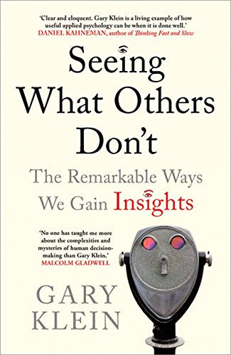
Naturalistic Decision-Making
Klein was particularly interested in the “tacit” (difficult to verbalise) knowledge which experts drew upon.
He focuses on insight over narrow conceptions of “error reduction”.
Much of his work is qualitative, but concerned in the actual, natural settings of experts.
Klein developed a methodology for trying to understand how experts arrive at their decisions.

Slide 33
Critical Decision Method
Klein believed that expertise was best demonstrated in particularly challenging incidents which pushes expertise to the limit, high stakes, dynamic environments.
Klein suggests that people don’t weigh up all possible options, but draw from their experience, to make appropriate choices.
Experts may use mental models and engage in mental simulation.
He designed an interview method to explore the sorts of knowledge people brought to bear which influenced their decision making.
Ask experts about a particularly challenging incident, then identify those “critical decisions”, and ask a series of probing questions about those decisions.
A “critical decision”, is something that a non-expert may have done differently.

Slide 34
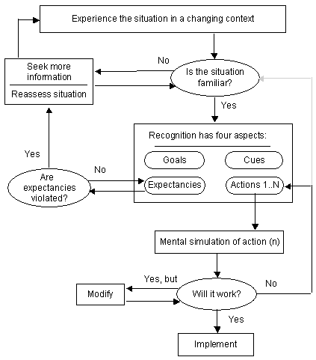
Recognition-Primed Decision-Making - Klein
Is situation typical?
Evaluate actions through mental simulation
Implement course of action
Klein (1993)

Slide 35
The Three Approaches (Reminder)
 | Rational Choice Theory | Heuristics and Biases | Naturalistic Decision Making
Central Idea | Humans behave rationally | Humans rely on heuristics and shortcuts. | Humans behave sensibly and can make rapid decisions under pressure
Main Theorists | Many (for instance Down’s 1957) | Kahneman and Tversky | Gary Klein
Areas of application | Economics, Political Science | Economics(ish), Psychology, Government, “Nudges”, “Freakanomics”, Behavioural economics | Training, Education, Psychology, Human Factors
Sources of Evidence | Mathematical Models, Computer simulation, Axiomatic Assumptions | Lab based experimental conditions | Study of Experts, real situations
Limitations | More of an “assumption” than a proper theory | Lab conditions and “forced choice” are not actually how people make decisions. | More descriptive, less predictive – focus on experts, not everyday scenarios

Slide 36
Conditions for Intuitive Expertise: A Failure to Disagree (Kahneman and Klein, 2009)
Article published with both Kahneman and Klein
As the title notes, these views aren’t completely opposite.
Kahneman – suggests overconfidence bias
Klein – suggests intuitive skill
Conditions for “Intuitive expertise” (a la Klein) are not a given, but learning has to take place in a predictable environment with the opportunity to learn its regularities.
Predictable environments; Chess, Giving a Lecture, Making a medical diagnosis(?), Firefighting
Unpredictable environments, Stock markets, Bitcoin prices, guessing coin flips
Opportunity for learning and feedback; Consistent feedback is a necessary condition for developing expertise.
Expertise of the sort that Klein suggests is only possible in predictable environments with an opportunity to learn.

Slide 37
Implications for Design – Heuristics and Biases
Is “slow” (System 2 thinking) appropriate? Can you interrupt the automatic decision-making system 1?
People may anchor on the first piece of information the encounter, can we present the order of things differently?
People might be tempted to continue with sunk-costs, how can we encourage forward looking decisions?
Confirmation bias, can we encourage people to look for information which might contradict what they believe?
People are loss-averse, can we frame forgone gains in the same way as losses?

Slide 38
Implications for Design – Naturalistic Decision-Making
Experts are valuable, retain their tacit knowledge.
What sources of information do the most experienced people use? Can we design systems utilising/prioritising these?
Create training manuals based on expert testimony.
People develop expertise in predictable environments with the opportunity to learn – can we create these environments and opportunities?
People

Slide 39
Summary
There are three basic frameworks for thinking about decision-making.
Rational Choice theory – Humans are self-maximising agents
Heuristics and Biases – Humans are fallible
Naturalistic Decision-Making – Experts have insight and tacit knowledge
“Rational choice theory” is more of an assumption used in economics and computer modelling than a fully worked out theory of human behaviour.
Heuristics and Biases approach, advocated by Kahneman and Tversky suggests that human rationality fails in a variety of ways and the brain depends upon “shortcuts” or heuristics.
Lots of biases; Loss aversion, sunk-costs, availability heuristic, representativeness, substitution
Evidence comes from “forced choice” studies within labs, artificial settings
VERY influential
Naturalistic decision-making seeks to understand how experts make decisions within environments
Evidence comes from expertise
Qualitative
Arguably more holistic, relates to genuine experiences

